Slide 1
Artificial intelligence
1.
Maria Markosova

Slide 2
Content
Repetition of basic concepts (agent- simple reflex, logical agent, searching, special kinds of searching)
Planning, POP plan, totally ordered plan, sensor less planning.
Monte Carlo methods, Minimax algorithm and Monte Carlo tree search.
Logical agents, inference, on the basis of the second order logic.
Probability in AI and Bayesian networks I
Bayesian inference – exact
Bayesian inference - estimates
Time series – classical, trend
Time series – classical, periodicity, randomness
Time series – AR. MA,ARMA, ARIMA models
Time series with uncertainty I, II.
Decision theory – general
Decisions in games, one move games, repetition games

Slide 3
You need at least 15 grades from exercises to the exam from Dr Náther.
You can get 40 grades from exercises and 60 grades is exam.
This lecture is a continuation of Introduction to AI, slides are on List
Slides from this lecture will be on List, or Moodle
Literature:
Russel, Norwig: Artificial Intelligence: A modern approach – available in the library
Nilsson: Artificial Intelligence: A New Synthesis – by me, I can borrow for a short time to do copies
For time series analysis, there is a sample of papers available on line. Ask me if you have troubles to find an appropriate one.

Slide 4


Basic AI concepts, repetition Agents
Agent in AI is a program, robot , softbot, men, machinery…. which percepts the environment in which he acts with a help of sensors and acts in the environment with a help of actuators.
Agent’s percept or a sequence of percepts is mapped to an action with a help of the agent’s function.
Realization of the agent function is an agent program.
Agent see a person
(percept)
Agent function
Agent lends a magnifying glass (action)

Slide 5
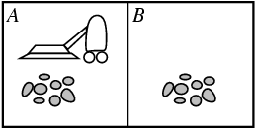
Agent function: matematic abstraction, mapping of the percept to the action
[f: P* → A]
Agent program: concrete realization of the agent function
Percept: Current state of the environment seen by the agent.
Action: Agent interference in the environment
Example:
Environment: two rooms, dirt
Agent: automatic vacuum cleaner vysávač
Percept: [A,1], [B,0] state of the room, location
Actions: Left , Right, Suck

Slide 6
Agent function: represented by the table for example
Percept sequence
Action
[A, Clean] =[A,0] Right
[A, Dirty] =[A.1] Suck
[B, Clean] =[B,0] Left
[B, Dirty] =[B,1] Suck
Agent program: table implementation, series of the if - then rules implementation
Performance measure (miera úspešnosti) : Measure defined by the programmer, measures the quality of the desirable environment state, the quality of how agent fulfills the task. Always contains time.
Examples:
Amount of dirt in kg per time unit.
Amount of agent steps per time unit.
Time by which the rooms stay clean.
Etc. = depending on the agent’s task
Rational agent: makes actions maximizing the performance measure

Slide 7
Simple agents - types
Simple reflex agents (jednoduchý reflexný agent)
Model-based reflex agents (refl. agent využívajúci model)
Goal-based agents (agent orientovaný na cieľ)
Utility-based agents (agent zohľadňujúci utilitu)
Utility function: Measure taking into account the price agent pays to perform a task. Agent tries to minimize this measure. Example for the vacuum cleaner world: energy /time

Slide 8
Reflex agents and knowledge based agents
Reflex agent: reacts to the percept or short percept sequence, such simple rules as if –
then rules are implemented in his agent program
KB agent: able to learn and infer new knowledge from the known ones. Knowledge
base (KB) is implemented to store the knowledge

Slide 9
Knowledge based agent (KB agent)
KB agent has:
KB, knowledge base, stores agent’s current knowledges about his world.
Background knowledge base; initial KB, can be empty
Reasoning algorithms, or mechanism.
How KB agent works?
Tells KB, about his percept. Funktion TELL.
Asks KB, about the appropriate actions. Function ASK.

Slide 10
Searching - short repetition
Searching problem – problem to find a path from the initial state to the goal state.
Searching problem characteristics: We need to define
Goal state, states – set of desirable environment states.
Initial state = state from which agent starts searching.
Goal test.
Actions applicable in each state
State space - directed graph in which nodes are states and
edges are actions.
Path cost– function, relating numerical value to each path in a
state space. It is a sum of step costs.
7. Step cost.

Slide 11
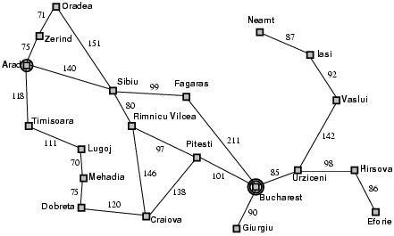
Searching problem example
Arad
Zerind
Sibiu
Timis.
Arad
Orad.
Searching tree: Created during search by the action application in the current state. Undeveloped nodes are ordered in some type of fringe.
Searching strategy: Node ordering in a fringe.

Slide 12
Basic searching strategies
In each node of a searching tree we
calculate :
Uninformed strategies:
breadth first (prehľadávanie do šírky) front FIFO, strategy is complete (always finds a goal), optimal (finds the best goal), time and memory complexity is exponential
uniform cost (strategia rovnomernej ceny) front best first, exponential time end memory complexity, complete and optimal if path cost is greater then zero.
depth first (prehľadávanie do hĺbky), front LIFO, time complexity is exponential, memory complexity is linear, not complete
Path cost from the initial node to the node x
Estimate of the path cost from x to the goal. Heuristics.

Slide 13
Informed strategies:
Front of the best first type:
Greedy best first search: , not complete
A* , complete, exp. time and memory complexity , best first ordering
in the fringe, first are the nodes with the smallest value of f(x). Heuristic function h(x), must be admissible, not overestimating the path cost
All of these algorithms were presented at the lectures for bachelor studies, Introduction to AI. It is desirable that those, not attending the subject look at the slides from the previous lectures.

Slide 14
More about searching – iterative deepening search. Korf, Stickel, Tyson (1985),
Method useful if we have no clue in which depth is a goal. The maximal depth of the tree is iteratively growing by one level.
Using for example depth first search, where the memory complexity is linear.
It seem, iterative deepening costs us a lot. Is it true? What is the price of iterative deepening?

Slide 15
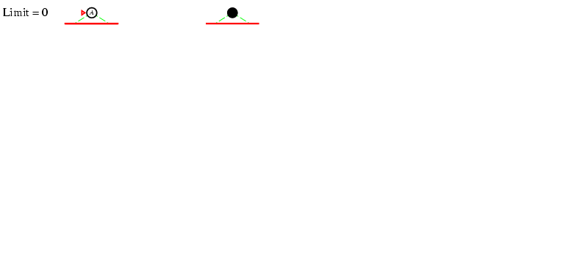
Iterative deepening search l =0, starts at zero – th limiting depth

Slide 16
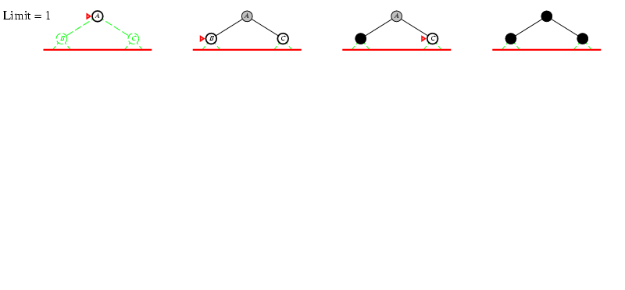
Iterative deepening search l =1

Slide 17
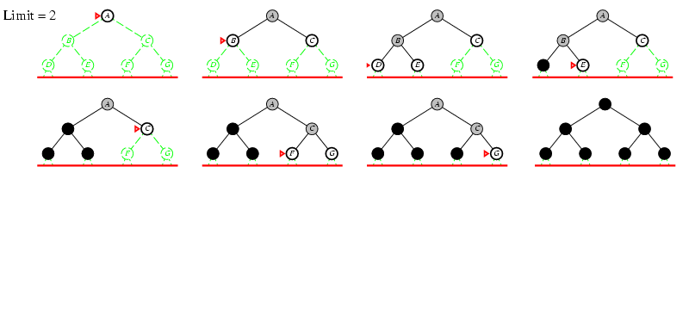
Iterative deepening search l =2

Slide 18
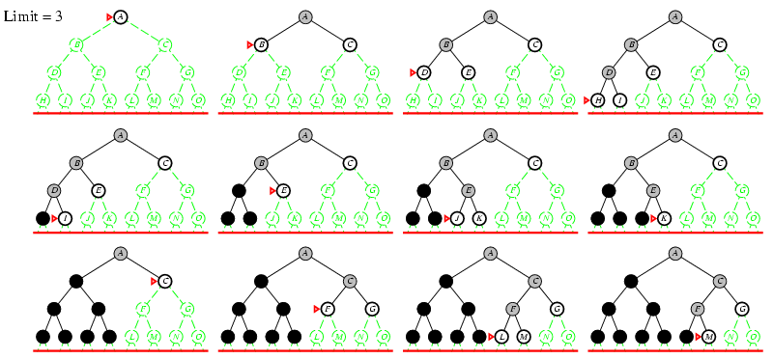
Iterative deepening search l =3

Slide 19
Iterative deepening search
Number of nodes generated by the depth limited search to the depth d if the branching factor is b:
N_{DLS} = b⁰ + b¹ + b² + … + b^{d-2} + b^{d-1} + b^{d}
Number of nodes generated for the iterative deepening search to the depth d if the branching factor is b:
N_{IDS} = (d+1)b⁰ + d b¹ + (d-1)b² + … + 3b^{d-2} +2b^{d-1} + 1b^{d}
For b = 10, d = 5,
N_{DLS} = 1 + 10 + 100 + 1,000 + 10,000 + 100,000 = 111,111
N_{IDS} = 6 + 50 + 400 + 3,000 + 20,000 + 100,000 = 123,456
How many percent more nodes is developed by the iterative deepening ? = (123,456 - 111,111)/111,111 = 11%

Slide 20
Generalozation:
Depth limited search – search in which we have one limit for the depth of the searching tree:
Depth limited search to the level j:
- To the level j
L
Notes:
Ak q je kvocient a a1 je prvy clen geom radu, potom sucet n clenov geom . radu je dany ako a (1-q**n)/(1-q).

Slide 21
Generalization:
Number of nodes developed by the iterative deepening search up to the level d if the branching factor is b:

Slide 22
Let d is big enough:
The ratio of the number of nodes developed by the IDS to the number of nodes developed by DLS providing we have the same branching factor for both, and limiting depth d is big enough, is not that bad. IDS as a method is a good one.

Slide 23
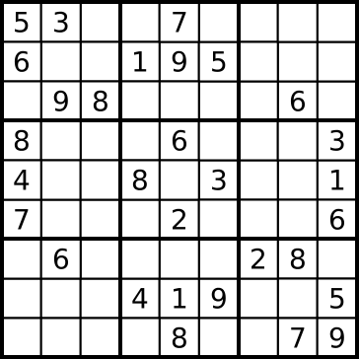
CSP problem as a special searching (Problémy zohĺadňujúce obmädzenia)
CSP definition:
Set of n variables (in sudoku n small square names x1, x2 ....)
Set of constrains (množina ohraničení, obmädzení)
Each variable has its value set (each x can have value from 1 to 9)
State : defined by the value assignment to the variables, not necessarilly to all.
Consistent state: assignment of values does not violate constrains.
Complete state: state in which each variable has a value.
Solution of CSP: complete state not violating constrains, complete consistent state
Example Sudoku

Slide 24

Example: Map-Coloring (Russel, Norwig)
Constrains:
Unary – constrains of one variable (WA cannot be green)
Binary- constrain two variables (two neighbor states cannot have the same colour)
n-ary constrains
Variables WA, NT, Q, NSW, V, SA, T
Domains D_{i} = {red, green, blue}
Constrains: different colours for neighbor countries e.g., WA ≠ NT, or (WA,NT) v {(red,green),(red,blue),(green,red), (green,blue),(blue,red),(blue,green)}

Slide 25
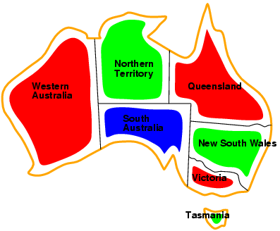
Example: Map-Coloring
One of the possible solutions: for example, WA = red, NT = green,Q = red, NSW = green,V = red, SA = blue,T = green

Slide 26
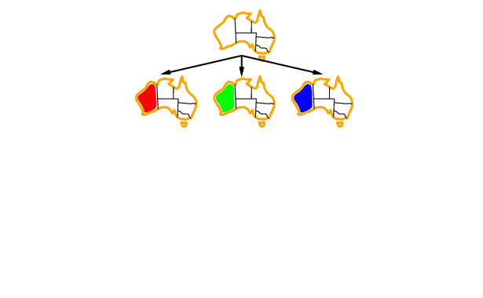
Backtracking example
Ordering of variables should be implemented.
Backtracking is a basic algorithm to solve CSP.

Slide 27
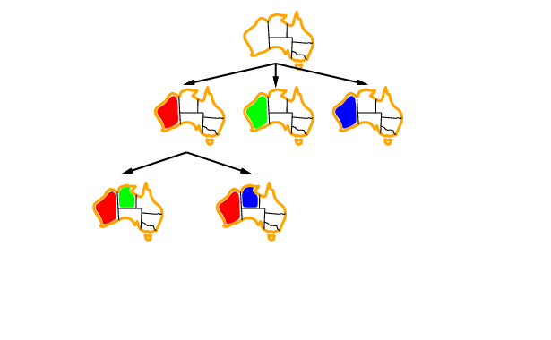
Backtracking example
Ordering of variables should be implemented.

Slide 28
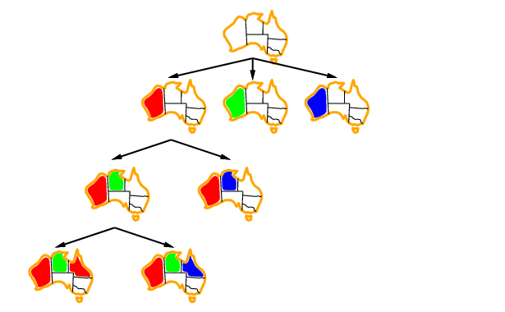
Backtracking example
Ordering of variables should be implemented.

Slide 29
Heuristics for CSP
Heuristics are oriented to find constraint violations as soon as possible. They does not estimate the distance from the goal as in typical heuristic searching.
Most constraint variable, alebo minimum remaining value (MRV) heuristics.
Most constraining variable, or degree heuristics.
Least constraining value heuristics.
Forward checking.
Alldiff and atmost constrain heuristics
All of these heuristics and more about CSP was presented at the lectures for bachelor studies, Introduction to AI. It is desirable that those, not attending the subject look at the slides from the previous lectures.

Slide 30
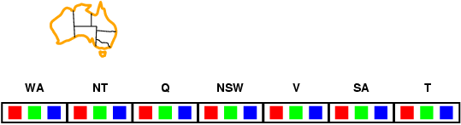
Forward checking – example of one heuristics
Assign color to the state X, then use process of forward checking and find Y constrained by X. From the value set of Y delete values inconsistent with the X value.
Idea:
Keep track of values for remaining unassigned variables.
Stop the search if there is no value for some variable.

Slide 31
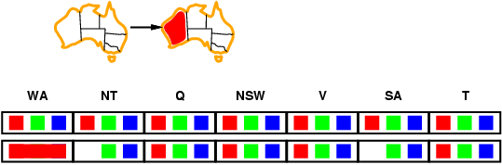
Forward checking
Idea:
Keep track of values for remaining unassigned variables.
Stop the search if there is no value for some variable.

Slide 32
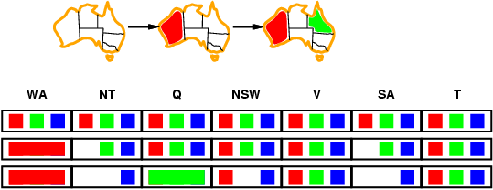
Forward checking
Idea:
Keep track of values for remaining unassigned variables.
Stop the search if there is no value for some variable.

Slide 33
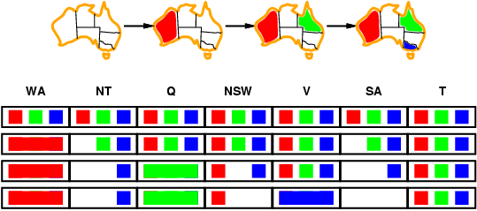
Forward checking
Idea:
Keep track of values for remaining unassigned variables.
Stop the search if there is no value for some variable.

Slide 34
Alldiff and Atmost heuristics
Alldiff
Atmost
Alldiff
Sum of values in some row (column) is (at most) 1+2+...+9. If for some value assignment this Atmost constraint is violated, we have a conflict set.
All of these states should have different colours (all different, ALLDIFF). If in some state of solution we find out there is not enough colors to fulfill Alldiff constraint, we have a conflict set.

Slide 35
Selected local search algorithms
Classical search: searches the state space systematically and keeps one on more paths in memory recording simultaneously which alternatives have been already searched. The path from the initial state to the goal is a solution.
Local search: The path to the goal is irrelevant. What is important is the quality of the solution, to what extend it is good or even optimal. Local search algorithms use a single state, the current state and evaluate its quality. If it is not sufficient, the algorithm explores neighbor states. The path to it is forgotten.
Local search use usually very little memory.
Basic local search algorithms
Hillclimbing algorithm (horolezecký algoritmus)
Evolutionary algoritm (evolučný algoritmus)
Simulated annealing (simulované žíhanie)

Slide 36
Selected local search algorithms (algoritmy lokálneho prehĺadávania)
These algorithms solve the so called optimization problems, that means they search for the maximum or minimum (optimum) of certain complex function evaluating the quality of the state, by improving the current state.
Hillclimbing algorithm
Evolutionary algorithm
Global extrem
Arm
Local extrem
Evaluation (fitnes) function
Plato
Initial state
state

Slide 37
Evolutionary algorithm – the most complete structure (Mach: Evolučné algoritmy – prvky a princípy)
Start
Generation of the population members
Inicialization
Evaluation of the population members
Stopping condition
If fulfilled then stop
nesplnená
selection
Reproduction
Genetic operators
Evaluation of a new population members

Slide 38
Replacement of the previous population
Migration
t=t+1

Slide 39


Example
We have a net of hexagonal rooms as on fig, Each room has 6 doors. In some of these rooms are treasure boxes (yellow circles).
The treasure hunter starts from the middle room . He is restricted to the 10 steps and 6 directions. If he hits the wall (boundary rooms) he stays in the current room.
S
SZ
SV
JZ
JV
S
J
SZ
SV
JZ
JV
J
The treasure hunter should visit as many as possible treasure rooms. Ideally 10, but we are satisfied if he visits 6 rooms. So the task is to find his most optimal movement.

Slide 40
What is the population element (chromosome)?
What is the evaluation (fitness)?
Number of visited treasure rooms.
What is the population ?
Set of elements represented by the chromosomes which encodes the treasure hunter movements.
3
Zero-th generation
3
2
What is the stopping condition?
If we find a population element encoding movement which visits 6 treasure rooms.

Slide 41
Fitness of the elements in the zero-th generation is 3, 3, 2. Average fitness is 2.67 .
Selection: Selection chooses parents to create elements of the new generation. The principle can be : the better is the fitness the greater is the probability to be chosen as a parent.
Probability of the chromosomes of the zero-th generation
3/8, 3/8, 2/8
Let the selection choses these

Slide 42
Offsprings after crossover
Offsprings after mutation
Fitnes: 2
4
To the next generation we chose three best chromosomes from the zero-th generation and offsprings. If there is no chromosome among them having the fitness 6, the process is repeated.

Slide 43
The example have shown the basics of the evolutionary algorithm. Hill climbing is a simplified version of it. We do not use crossover operator. Only the mutation operator is used and the population consists of one chromosome .
In the zero-th iteration the best fit
chromosome is:
By a mutation
(changing the randomly chosen
direction) we create several new
Chromosomes and evaluate them
7
3
0
6
If the best offspring is better as the zero-th generation chromosome (parent), this offspring became a parent and is mutated to produce new offsprings. This process is repeated, until the global extremum is reached, or the stop condition is met. Problem: cycling of the algorithm, algorithm can get stuck at plato, arm (slow convergence) or local extremum.

Slide 44
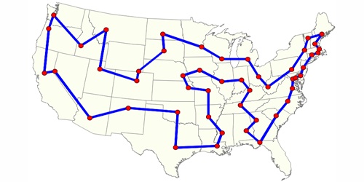
Hillclimbing – traveling salesman example
Traveling salesman problem: Traveling salesman needs to visit N towns. He starts in the town 1 and ends his travel in the town 1. He visited all towns at most ones (except of the town 1).
The salesman wants to find
such town ordering, that the
path he travels is the shortest
one .

Slide 45
Travel path of the salesman is represented as a vector of the town indexes: (1,3,5,2,7,6,8,4,9,10,1).
We start from certain initial town ordering. Each initial vector can be evaluated (path length).
Question; If there are 10 towns, how many possible paths we have in the traveling salesman problem?
10!
Current initial vector is perturbed, several new orderings are created. All of them are evaluated.
The initial vector is replaced by the best offspring, but only if the offspring is better then the current initial vector. If not, we do not replace current initial vector.
Repeat from 3. until the stopping condition is met.

Slide 46
Simulated annealing
Simulated annealing is another type of local search. It is different from the evolutionary algorithm and hill climbing. Similarly to the hill climbing it uses only one state, which is disturbed. But contrary to the hill climbing and evolutionary algorithm it accepts also a worse states but with certain probability.
Simulated annealing works with the concept of “energy function” - the one of which we are looking for the optimum and “temperature” a constant which governs the acceptance of a worse state.
These concepts are used due to the first formulation of the algorithm in solving physical problems.

Slide 47
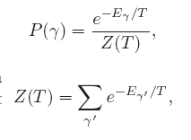
What is „energy“ in the simulated annealing?
“Energy “ is a function which minimum one seeks (length of the path in the traveling salesman example). It is similar to the cost function or fitness function evaluating the quality of the current state (length of the current path).
What is „temperature “ in the simulated annealing?
It is a constant (at fixed temperature) which governs the probability to accept worse configuration then the current one (with the higher energy)
Current configuration
Temperature dependent normalizing factor.

Slide 48
Simulated Annealing Metropolis Algorithm
Step 1: Initialize – Start with a random initial placement of towns for
example. Initialize at a very high “temperature”.
Step 2: Move – Perturb the placement through a defined move.
Step 3: Calculate score (energy) – calculate the change in the score
(“energy”)due to the move made.
Step 4: Choose – Depending on the change in score, accept or reject
the move. The probability of acceptance of the worse state is
depending on the current “temperature”. Repeat from 2 several
times.
Step 5: Update and repeat– Update the temperature value by lowering
the temperature. Start with the best state at the former
temperature. Go back to Step 2.
The process is done until “Freezing Point” is reached.

Slide 49
The code, cycle for certain temperature
1. Create random initial solution γ
2. E_{old}=cost(γ);
3. for(temp=temp_{max}; temp>=temp_{min};temp=next_temp(temp) ) {
4. for(i=0;i<i_{max}; i++ ) {
5. succesor_func(γ); //this is a randomized function
6. E_{new}=cost(γ);
7. delta=E_{new}-E_{old;}
8. if(delta>0)
9. if(random() >= exp(-delta/K*temp);
10. undo_func(γ); //rejected bad move
11. else
12. E_{old}=E_{new} //accepted bad move
13. else
14. E_{old}=E_{new;} //always accept good moves
}
}
Then the temperature is lowered and the cycle is repeated

Slide 50
Traveling salesman example.
1
1
6
2
6
2
5
3
5
3
4
4
s=(1,2,5,4,3,6,1)
Initial configuration
Disturbed configuration
f(s) – “energy” or cost function we are minimalizing – the overall distance salesman travel visiting all towns. We want to find a configuration which minimizes this distance.

Slide 51
Metropolis algorithm for the traveling salesman problem
Initialize: Choose initial town ordering, configuration for example randomly. Calculate the travelled distance for this ordering. This is „energy“ – evaluating the quality of the configuration. The goal is to minimalize this function, to find a configuration with minimal energy. The initial temperature should be great, such , that the worse configuration acceptance probability is close to 1.
Move: Perturb the initial town ordering.
Calculate the acceptance probability if the traveled distance of the perturbed configuration is longer then the previous one.
Accept or reject the move: if the energy of the perturbed configuration is better then previous one, accept with probability one, if worse accept with the calculated probability.
Repeat from 2) m times for the current temperature and find the best configuration for this temperature. This will be the initial configuration after cooling
Lower the temperature. That means we lower also the probability of the acceptance of the worse configuration. Repeat from 2 for the new temperature.

Slide 52
Cooling
As we lower the temperature , we sometimes also slow the cooling by constraining
Basic Problems
Traveling salesman
Graph partitioning
Matching problems
Graph coloring
Scheduling
Engineering
VLSI design
Placement
Routing
Array logic minimization
Layout
Facilities layout
Image processing
Code design in information theory
Applications

Slide 53
Simulated annealing search properties
It is possible to prove mathematically, that if the temperature decreases very, very slowly, the algorithm finds global optimum with the probability close 1.

Slide 54
Summary
Repetiton of AI basic concepts.
Agents, searching , CSP.
Local search in general
Evolutionary algorithm, hill climbing, simulated annealing

